Slide 2
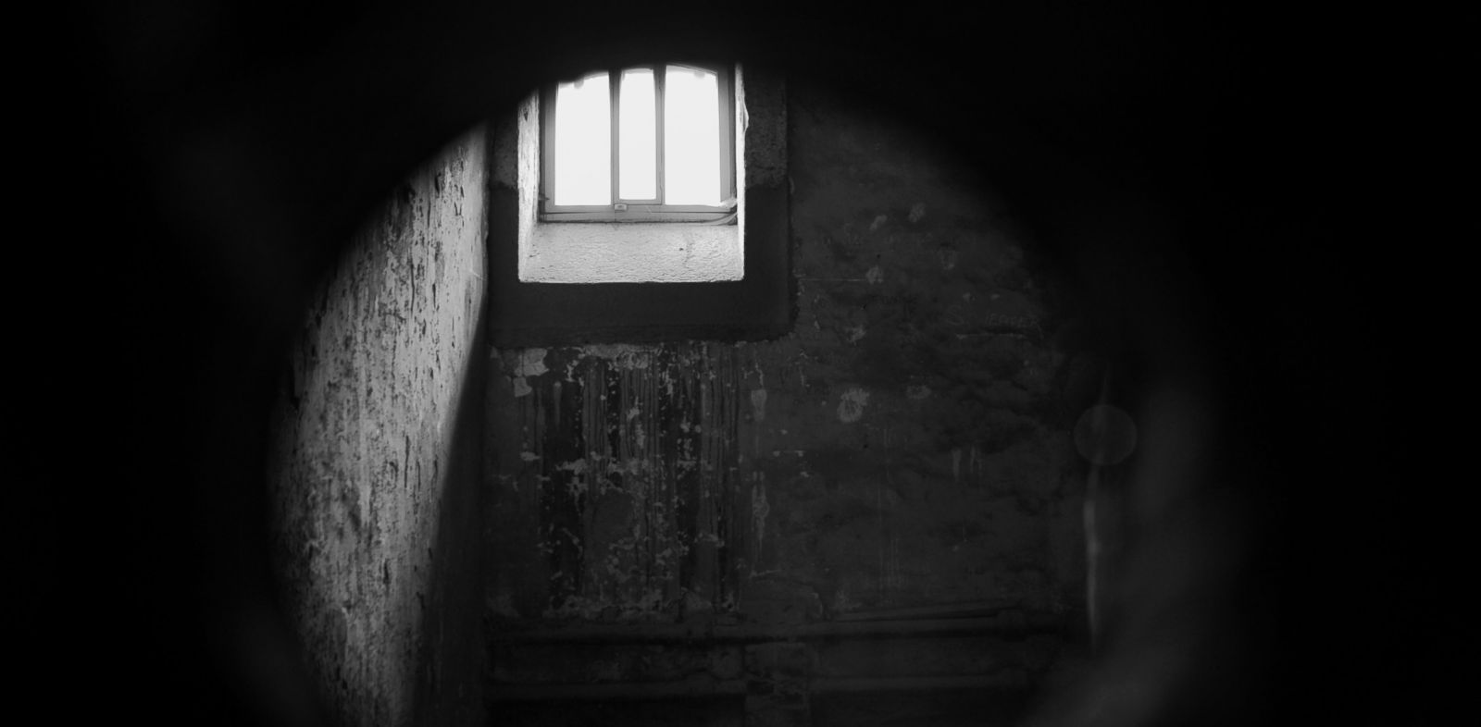
GOSPEL
friendships
Philippians 1:3-11
Lifelong Affectionate Edifying
I thank my God in all my remembrance of you, always in every
prayer of mine for you all making my prayer with joy, because of
your partnership in the gospel from the first day until now.
And I am sure of this, that he who began a good work in you
will bring it to completion at the day of Jesus Christ.

Slide 3
GOSPEL
friendships
Philippians 1:3-11
Lifelong Affectionate Edifying
It is right for me to feel this way about you all,
because I hold you in my heart, for you are all partakers with me
of grace, both in my imprisonment and in the defense
and confirmation of the gospel. For God is my witness,
how I yearn for you all with the affection of Christ Jesus.

Slide 4
GOSPEL
friendships
Philippians 1:3-11
Lifelong Affectionate Edifying
It is my prayer that your love may abound more and more,
with knowledge and all discernment,
so that you may approve what is excellent,
and so be pure and blameless for the day of Christ,
filled with the fruit of righteousness that comes through Jesus Christ,
to the glory and praise of God.

Slide 5
GOSPEL
affliction
Philippians 1:12-18a
The Gospel is advancing
What has happened to me has really served to advance the gospel, so that it has become known throughout the whole imperial guard and to all the rest that my imprisonment is for Christ.

Slide 6
GOSPEL
affliction
Philippians 1:12-18a
People emboldened to speak the Word
And most of the brothers, having become confident in the Lord by my imprisonment, are much more bold to speak the word without fear.

Slide 7
GOSPEL
affliction
Philippians 1:12-18a
Christ is being proclaimed
Some indeed preach Christ from envy and rivalry, but others from good will… The former proclaim Christ out of selfish ambition, not sincerely but thinking to afflict me in my imprisonment. What then? Only that in every way, whether in pretense or in truth,
Christ is proclaimed, and in that I rejoice.

Slide 8
GOSPEL
service
Philippians 1:18b-2:30

Slide 9
Philippians 1:27-29 ²⁷ Only let your manner of life be worthy of the gospel of Christ
… ²⁹ For it has been granted to you that
for the sake of Christ you should
not only believe in him
but also suffer for his sake.

Slide 10
Philippians 2
¹ So if there is any encouragement in Christ…
² complete my joy by being of the same mind. ³ Do nothing from selfish ambition or conceit, but in humility count others more significant than yourselves.
⁴ Let each of you look not only to his own interests,
but also to the interests of others.
⁵ Have this mind among yourselves, which is yours in Christ Jesus, ⁶ who, though he was in the form of God,
did not count equality with God a thing to be grasped, ⁷ but emptied himself, by taking the form of a servant, being born in the likeness of men.

Slide 11
Philippians 2
¹⁴ Do all things without grumbling or disputing,
¹⁵ that you may be blameless and innocent,
children of God without blemish in the midst
of a crooked and twisted generation,
among whom you shine as lights in the world,
¹⁶ holding fast to the word of life…
¹⁷ Even if I am to be poured out as a drink offering upon the sacrificial offering of your faith,
I am glad and rejoice with you all.

Slide 12
Timothy
&
Epahroditus

Slide 13
GOSPEL
mission
Philippians 3:1-21
Remove the PRESENT distractions
¹ Finally, my brothers, rejoice in the Lord.
² Look out for the dogs, the evildoers, look out for those who mutilate the flesh. ³ For we are the circumcision, who worship by the Spirit of God and glory in Christ Jesus and put no confidence in the flesh— ⁴ though I myself have reason for confidence in the flesh. … ⁷ But whatever gain I had, I counted as loss for the sake of Christ. ⁸ Indeed, I count everything as loss because of the surpassing worth of knowing Christ Jesus my Lord. For his sake I have suffered the loss of all things and count them as rubbish, in order that I may gain Christ ⁹ and be found in him.

Slide 14
GOSPEL
mission
Philippians 3:1-21
Forget what is in the PAST
¹² Not that I have already obtained this or am already perfect, but I press on to make it my own, because Christ Jesus has made me his own.
¹³ Brothers, I do not consider that I have made it my own. But one thing I do: forgetting what lies behind
and straining forward to what lies ahead,

Slide 15
GOSPEL
mission
Philippians 3:1-21
Press on for the PRIZE
¹² Not that I have already obtained this or am already perfect, but I press on to make it my own, because Christ Jesus has made me his own.
¹³ Brothers, I do not consider that I have made it my own. But one thing I do: forgetting what lies behind
and straining forward to what lies ahead, ¹⁴ I press on toward the goal
for the prize of the upward call of God in Christ Jesus.

Slide 16
GOSPEL
living
Philippians 4:1-23

Slide 17
Stand firm by agreeing in the Lord
^{4:2} I entreat Euodia and I entreat Syntyche to agree in the Lord.
³ Yes, I ask you also, true companion, help these women,
who have labored side by side with me in the gospel.
AGAINST ANGER

Slide 18
Stand firm by prayer with thanksgiving
⁶ do not be anxious about anything, but in everything by prayer and supplication with thanksgiving let your requests be made known to God. ⁷ And the peace of God…will guard your hearts and minds in Christ Jesus.
And by right thinking with practice
⁸ whatever is true… honorable… just… pure… lovely… commendable, if there is any excellence, anything worthy of praise, think about these things. ⁹ What you have learned and received and heard and seen in me— practice these things, and the God of peace will be with you.
AGAINST ANXIETY

Slide 19
Stand firm by being content
¹⁰ I rejoiced in the Lord greatly that now at length you have revived
your concern for me. You were indeed concerned for me,
but you had no opportunity. ¹¹ Not that I am speaking of being in need,
for I have learned in whatever situation I am to be content.
¹² I know how to be brought low, and I know how to abound.
In any and every circumstance, I have learned the secret of facing plenty and hunger, abundance and need. ¹³ I can do all things through him who strengthens me.
AGAINST AGITATION

