Slide 1
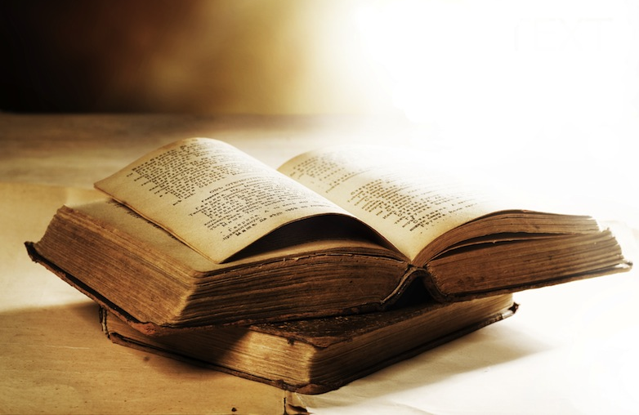
THE ST RY
66

Slide 2
Isaiah’s focus: The salvation that will come through the
Messiah

Slide 3
Isaiah is the first of 17 Prophetic Books
4000+
1400
930
722
539
400
1445
1405
1050
586
Exodus
Proverbs
ASSYRIA
conquers
Israel
Esther
Psalms
Judges
EXILE
Captives in Babylon
Numbers
Nehemiah
Genesis
Northern Kingdom (10 Tribes): Israel
Joshua
Ecclesiastes
Ezra
Leviticus
Southern Kingdom (2 Tribes): Judah
Ruth
Song of Songs
Isaiah
1 & 2 Samuel
Job
Deuteronomy
1 & 2 Kings
1 & 2 Chronicles
Egypt Assyria Babylon Persia

Slide 4
Chapters 1-12: Restoration through redemption
Chapters 13-23:
List of nations to be punished
Chapters 24-27:
Announcing God’s new work
Chapters 28-39:
Military might - not God’s way
Chapters 40-55:
Comfort to those who suffered
Chapters 55-66:
Renewed definition of God’s salvation

Slide 5
THE BOOK OF
is like a
miniature
BIBLE
Chapters
First
Last
66
39
27
like the Bible
like O.T.
like N.T.

Slide 6
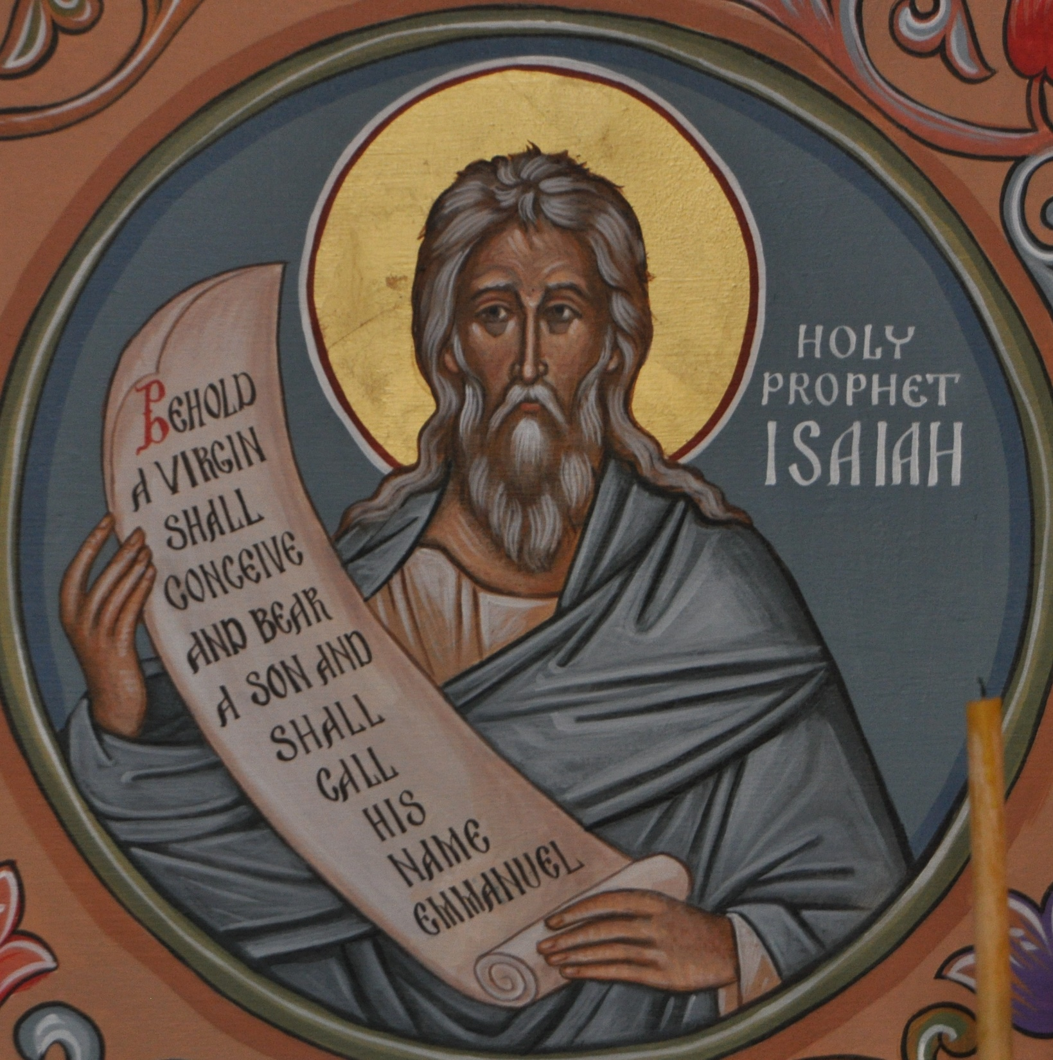
Isaiah 1:21-23
“How the faithful city has become a whore, she who was full of justice! Righteousness lodged in her, but now murderers. Your silver has become dross, your best wine mixed with water. Your princes are rebels and companions of thieves. Everyone loves a bribe and runs after gifts They do not bring justice to the fatherless, and the widow’s cause does not come to them.”

Slide 7
Isaiah receives his calling in 6:1-5
In the year that King Uzziah died I saw the Lord sitting upon a throne, high and lifted up; and the train of his robe filled the temple. Above him stood the seraphim… And one called to another and said: “Holy, holy, holy is the Lord of hosts; the whole earth is full of his glory!” And the foundations of the thresholds shook at the voice of him who called, and the house was filled with smoke. And I said: “Woe is me! For I am lost; for I am a man of unclean lips, and I dwell in the midst of a people of unclean lips; for my eyes have seen the King, the Lord of hosts!”

Slide 8
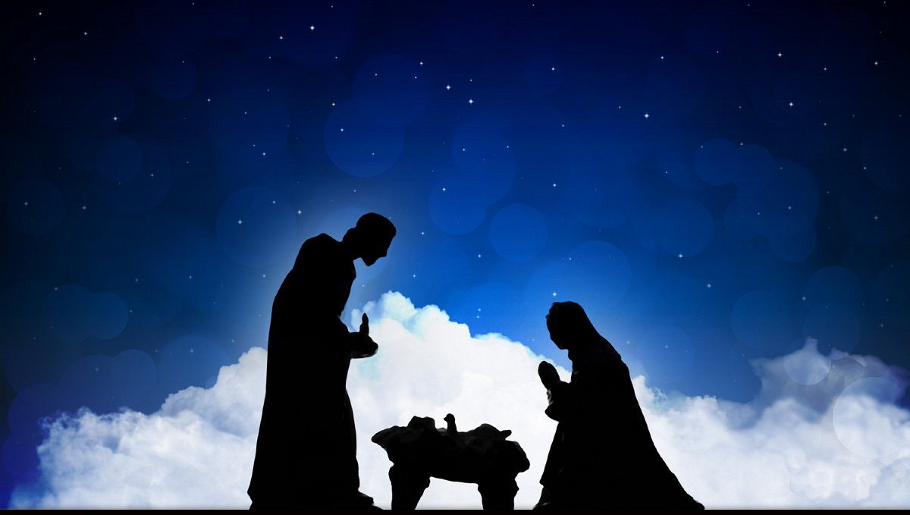
Peace and prosperity will come through the Prince of Peace
The people who walked in darkness have seen a great light; those who dwelt in a land of deep darkness, on them has light shone. …
For to us a child is born, to us a son is given; and the government shall be upon his shoulder, and his name shall be called Wonderful Counselor,
Mighty God, Everlasting Father, Prince of Peace. Of the increase of his government and of peace there will be no end…
Isaiah 9:2, 6-7

Slide 9
He calls us out of a spiritual death
He calls us out of a spiritual holding pattern
He calls us to second chances after failure

Slide 10
The “anointed one” (Messiah) will come
He was despised and rejected by men; a man of sorrows…
Surely he has borne our griefs and carried our sorrows…
But he was pierced for our transgressions…
and with his wounds we are healed…

Slide 11
Isaiah 55:6-11
Seek the Lord while he may be found; call upon him while he is near;
let the wicked forsake his way, and the unrighteous man his thoughts;
let him return to the Lord, that he may have compassion on him, and to our God, for he will abundantly pardon. For my thoughts are not your thoughts, neither are your ways my ways, declares the Lord. For as the heavens are higher than the earth, so are my ways higher than your ways and my thoughts than your thoughts. “For as the rain and the snow come down from heaven and do not return there but water the earth, making it bring forth and sprout, giving seed to the sower and bread to the eater, so shall my word be that goes out from my mouth; it shall not return to me empty, but it shall accomplish that which I purpose, and shall succeed in the thing for which I sent it.

Slide 12
Isaiah 55:6-11
Seek the Lord while he may be found; call upon him while he is near;
let the wicked forsake his way, and the unrighteous man his thoughts;
let him return to the Lord, that he may have compassion on him, and to our God, for he will abundantly pardon. For my thoughts are not your thoughts, neither are your ways my ways, declares the Lord. For as the heavens are higher than the earth, so are my ways higher than your ways and my thoughts than your thoughts. “For as the rain and the snow come down from heaven and do not return there but water the earth, making it bring forth and sprout, giving seed to the sower and bread to the eater, so shall my word be that goes out from my mouth; it shall not return to me empty, but it shall accomplish that which I purpose, and shall succeed in the thing for which I sent it.
CLAIM God’s Word – it stands secure
Stand FIRM and when necessary stand ALONE
Be the VOICE in the wilderness

